Slide 1

Payments infrastructure for the internet

Slide 2
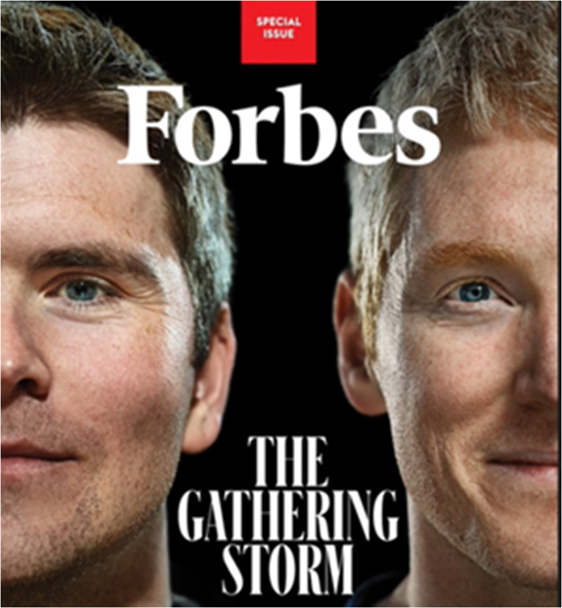
PRESENTERS:
GAURI
ROSHNI
TAARAN
SAHIL
LAKSHITHA
SANJEEV

Slide 3

FOUNDER’S STORY
STRIPE’S BORN IN 2010
PATRICK COLLISON
CEO, STRIPE INC.
JOHN COLLISON
PRESIDENT, STRIPE INC.
The Brain Child of $ 95 Bn Unicorn
https://www.limerickpost.ie/2023/06/08/collison-brothers-acquire-us-tech-startup/

Slide 4
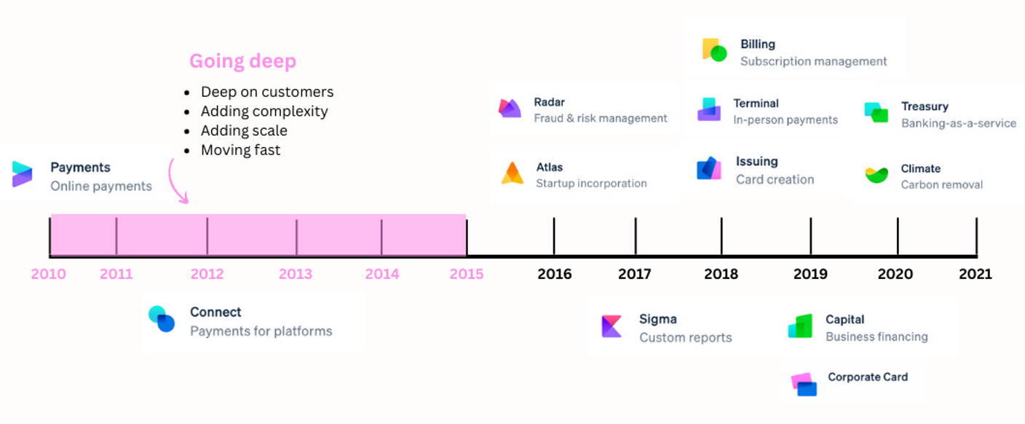
STRIPE’S PRODUCT RELEASE TIMELINE
https://www.howtheygrow.co/p/how-stripe-grows

Slide 5
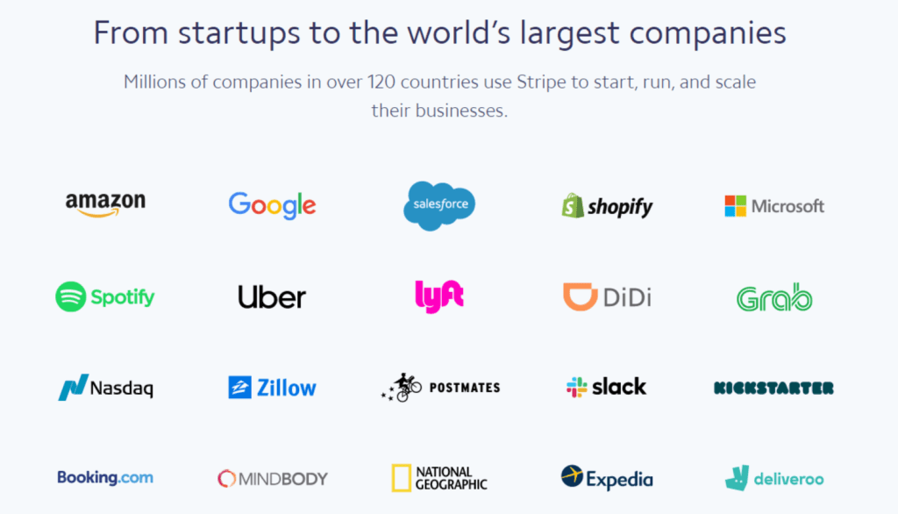
STRIPE’S MARKET DOMINANCE

Slide 6
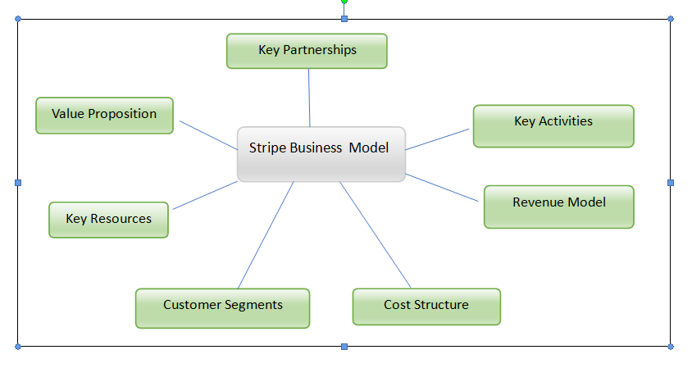
BUSINESS MODEL

Slide 7
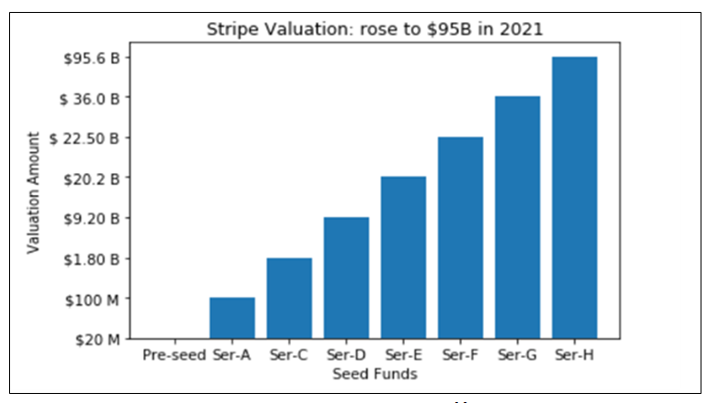
LEADING INVESTORS
Y COMBINATOR
PETER THIEL
SEQUOIA CAPITAL
ELON MUSK
TIGER GLOBAL
MANAGEMENT
ALLIANZ INSURANCE
IRELAND NATIONAL TREASURY

Slide 8
KEY TO THE SUCCESS - SIMPLICITY
FORESIGHTEDNESS
AFFORDABLE SERVICE
INNOVATION
TRANSPARENT PRICING

Slide 9
THANK YOU

